Slide 1
Customer Segmentation
Week 5

Slide 2
Introduction
Customer segmentation is a method of dividing customers into groups or clusters based on common characteristics. The market researcher can segment customers into the B2C model using various customer's demographic characteristics such as occupation, gender, age, location, and marital status. Psychographic characteristics such as social class, lifestyle and personality characteristics and behavioral characteristics such as spending, consumption habits, product/service usage, and previously purchased products. In the B2B model using various company's characteristics such as the size of the company, type of industry, and location.

Slide 3
Datasets: Mall Customer Data
The first dataset is based of customers who spend in the mall. You are owing a supermarket mall and through membership cards, you have some basic data about your customers like Customer ID, age, gender, annual income and spending score. Spending Score is something you assign to the customer based on your defined parameters like customer behavior and purchasing data.

Slide 4
Datasets: E-commerce Customer Data
InvoiceNo: Invoice number. Nominal, a 6-digit integral number uniquely assigned to each transaction. If this code starts with letter 'c', it indicates a cancellation.\
StockCode: Product (item) code. Nominal, a 5-digit integral number uniquely assigned to each distinct product.
Description: Product (item) name. Nominal.
Quantity: The quantities of each product (item) per transaction. Numeric.
InvoiceDate: Invice Date and time. Numeric, the day and time when each transaction was generated.
UnitPrice: Unit price. Numeric, Product price per unit in sterling.
CustomerID: Customer number. Nominal, a 5-digit integral number uniquely assigned to each customer.
Country: Country name. Nominal, the name of the country where each customer resides.

Slide 5
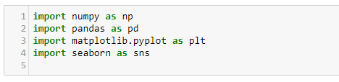
Methodology
Import libraries
Data pre-processing
K Means model [Mall customer Data]
RFM - Recency Frequency Monetary analysis [E-Commerce Data]

Slide 6
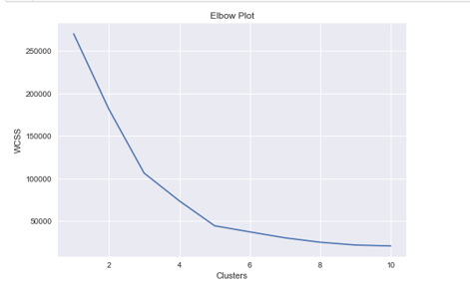
Elbow chart
After some data wrangling used the clean data to make clusters using K means algorithm.
To decide an appropriate value of clusters (k) used the elbow chart

Slide 7
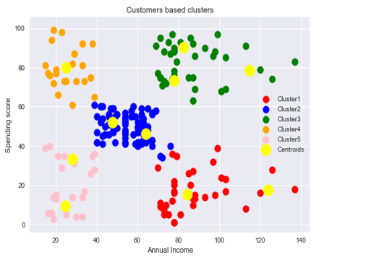
Visualizing the clusters and its interpretation
Cluster 1 (Red Color) -> earning high but spending less
cluster 2 (Blue Color) -> average in terms of earning and spending
cluster 3 (Green Color) -> earning high and spending high [TARGET SET]
cluster 4 (Orange Color) -> earning less but spending more
Cluster 5 (Pink Color) -> Earning less, spending less

Slide 8
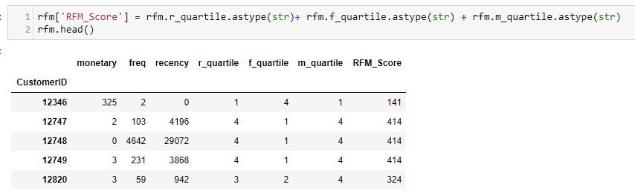
RFM Analysis
For Recency, Calculate the number of days between present date and date of last purchase each customer.
For Frequency, Calculate the number of orders for each customer.
For Monetary, Calculate sum of purchase price for each customer.

Slide 9
Conclusion
RFM analysis helps managers to identify potential customers to do more profitable business. There is a segment of customer who is the big spender but what if they purchased only once or how recently they purchased? Do they often purchase our product? Also, it helps managers to run an effective promotional campaign for personalized service.

